Slide 1


FB-CPU RTL DESIGN
TAHA KEREM ERIS -210304032
MUHAMMED YASIN IMRE- 220304004
AHMET EMIR DAGISTANLI -220304501
OZAN CAGILLIGECIT - 220304015

Slide 2

PURPOSE OF PROJECT
The FB-CPU design is rooted in the VON-NEUMANN architecture, incorporating a finite state machine. Testing was conducted using assembly language test codes, with the utilization of control units and ALU systems.

Slide 3
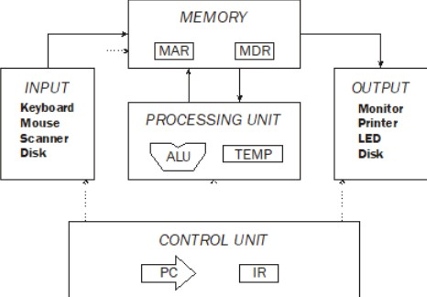
System Architecture
The system architecture is comprised of four essential components:
Registers
Memory (RAM)
Registers can store, and manipulate data during the execution instructions and do this through flip-flop circuits..
The memory unit stores operation commands and variables.
Processing Unit (ALU)
Control Unit
The processing unit carries out arithmetic and logic operations.
The control unit is essential for decoding commands.

Slide 4
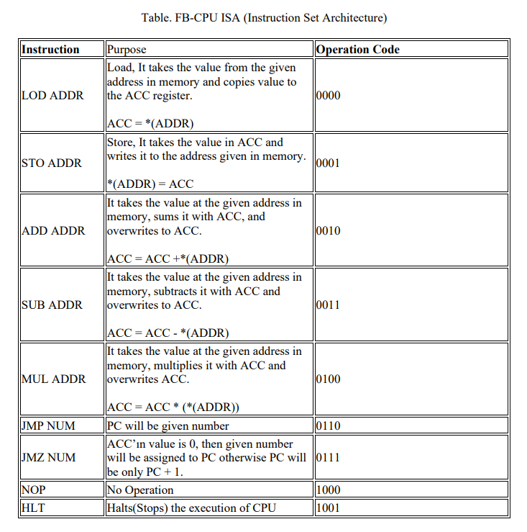
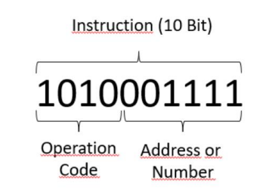
FB-CPU Supported Operations
FB-CPU Operations
10-Bit Command Breakdown
The CPU supports 9 operations listed in Table 1.
Figure 3 illustrates the breakdown of FB-CPU's 10-bit command for operations and addresses.
Figure 3. Example command binary representation

Slide 5

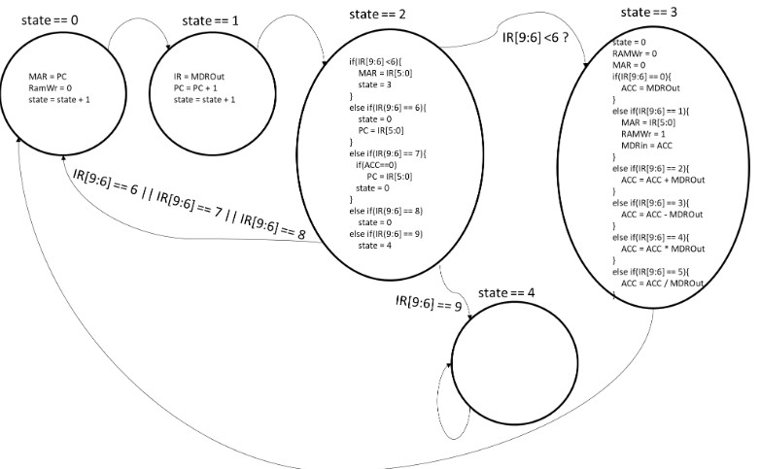

Software Implementation
State Machine Coding
The design was encoded as a state machine, as depicted in Figure , showing the step-by-step tasks the processor needs to perform.
Usage of State Register
The use of a state register is essential for determining the timing of all operating mechanisms.

Slide 6
The memory signals connected to the input-output ports in the figure are given below.
• MAR (6 Bit): It is a register called Memory Address Register. This register is connected to the address input of RAM. Since RAM has 2^6 locations, MAR is 6 bits. The saver is inside RAM.
• MDRIn (10 Bit): Memory Data Register In is the register used when data is written to RAM. Since one location of RAM is 10 bits, the register is 10 bits. The saver is inside RAM.
• RAMWr (1 Bit): It is activated when data will be written to RAM. If it is not 1, no data is written to RAM. The saver is inside RAM.
• MDROut (10 Bit): Memory Data Register is the register used when data is read from RAM. Since one location of RAM is 10 bits, the register is 10 bits. The saver is inside RAM.

Slide 7
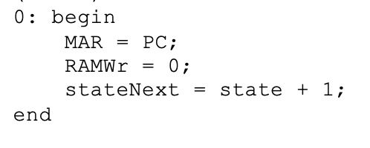
Processor State - 0
1
MAR = PC;: The address within the Program Counter (PC) is transferred to the Memory Address Register (MAR). This sets the address for the next memory access.
2
No write operation was performed, so the write signal (RamWr) was set to 0, and the state incremented to 1.
The Program Counter (PC) address is transferred to the Memory Address Register (MAR), no RAM write operation occurs, and the processor transitions to the next state. In this state, the processor becomes ready to read the instruction at the next memory address.
3
stateNext = state + 1;: The state is incremented to transition to the next state. In this case, the next state facilitates the execution of the next instruction.

Slide 8

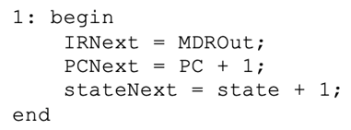
Processor State - 1
IRNext = MDROut;: The content of the Memory Data Register Output (MDROut), which holds the instruction read from memory, is assigned to the Instruction Register (IR). This step fetches the instruction from memory and loads it into the IR.
PCNext = PC + 1;: The Program Counter (PC) is incremented by 1, preparing it for the next instruction. This reflects the sequential execution of instructions in program memory.
In summary, state 1 is responsible for fetching the instruction from memory, loading it into the Instruction Register (IR), incrementing the Program Counter (PC) for the next instruction, and transitioning to the next state to continue the instruction execution cycle.
stateNext = state + 1;: The state is incremented to transition to the next state. This prepares the processor for the next phase of the instruction execution cycle.
3

Slide 9
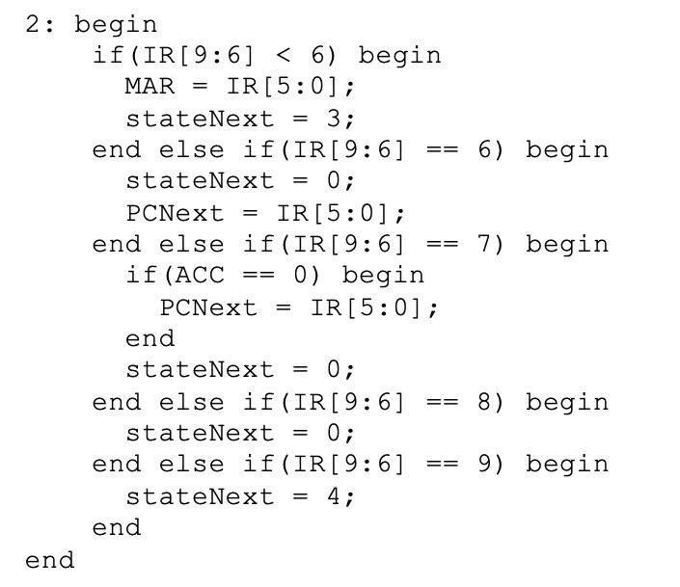
Processor State - 2
If the top 4 bits of the instruction (IR[9:6]) are less than 6, the processor takes the following actions:
If IR[9:6] is less than 6, update the Memory Address Register (MAR) with the lower 6 bits of the instruction (IR[5:0]) and transition to state 3 for memory read or write operations.
If IR[9:6] is not less than 6, proceed to the next condition:
If IR[9:6] is equal to 6, transition to state 0 and update the Program Counter (PC) with the lower 6 bits of IR to execute the next instruction.
If IR[9:6] is equal to 7 and the Accumulator (ACC) is 0, update PC with the lower 6 bits of IR and transition to state 0.
If IR[9:6] is equal to 8, transition to state 0.
If IR[9:6] is equal to 9, transition to state 4 to prepare for jumping to a specific address based on a condition.
These conditions create distinct control flows based on the values of specific bits in IR, allowing the processor to execute specific commands.

Slide 10
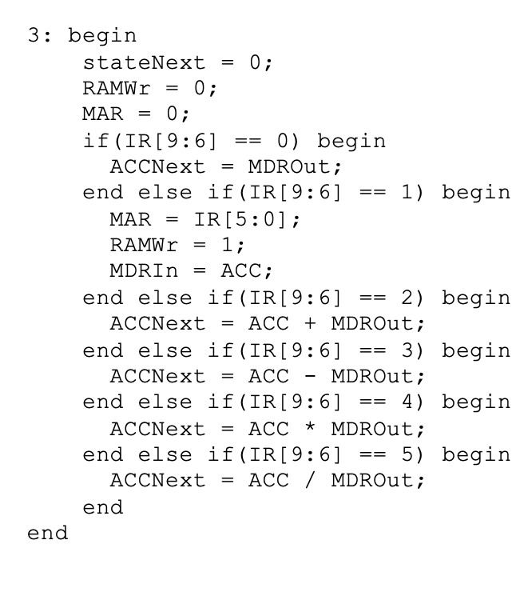
Processor State - 3
Initialize the stateNext variable to 0, marking the transition to the state where the next instruction will be fetched, completing the current instruction execution cycle. Set RAMWr to 0, indicating that no memory write operation will occur in this state. Clear the Memory Address Register (MAR) to 0, as it is not needed beyond this state.
Conditional operations based on the value of the top 4 bits (IR[9:6]) of the instruction are as follows:
a. If IR[9:6] is 0, assign the content of the Memory Data Register Output (MDROut) to the Accumulator (ACC), typically representing a load operation.
b. If IR[9:6] is 1, update the Memory Address Register (MAR) with the lower 6 bits of the instruction, set RAMWr to 1, indicating a memory write operation, and write the content of the Accumulator (ACC) to the memory address specified by MAR, typically representing a store operation.
c. If IR[9:6] is 2, update the Accumulator by adding the current value to the content of MDROut, typically representing an addition operation.
d. If IR[9:6] is 3, update the Accumulator by subtracting the content of MDROut from its current value, typically representing a subtraction operation.
e. If IR[9:6] is 4, update the Accumulator by multiplying its current value with the content of MDROut, typically representing a multiplication operation.
f. If IR[9:6] is 5, update the Accumulator by dividing its current value by the content of MDROut, typically representing a division operation. These operations collectively execute arithmetic and data transfer instructions in the processor, with the specific operation determined by the top 4 bits of the instruction.
1
2

Slide 11

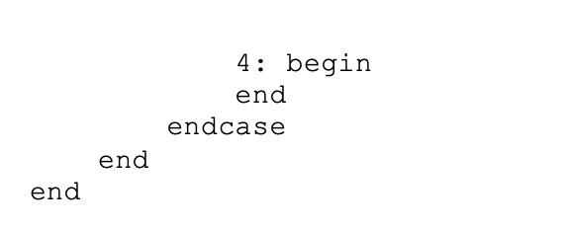
Processor State - 4
In case 4 nothing is checked, nothing is done it just spins on.

Slide 12

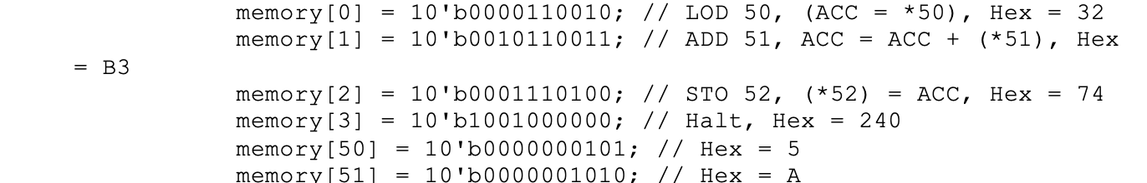
Test Software - 1
1
Initial Operations
The software conducts testing with a series of initial operations, accompanied by specific command sequences.

Slide 13
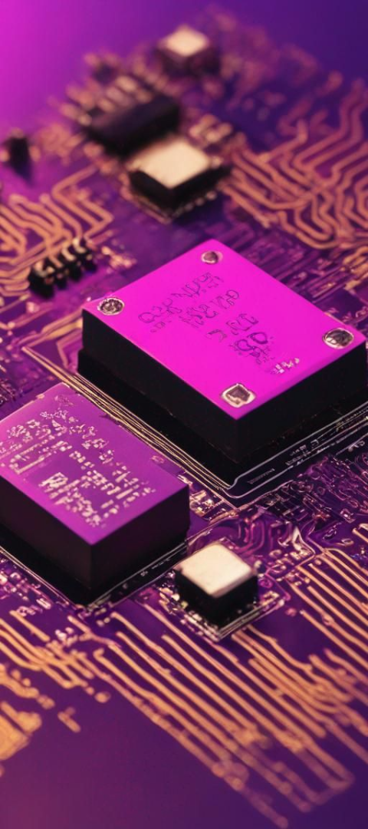
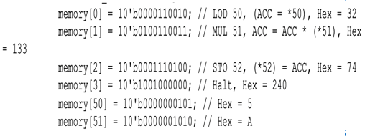
Test Software - 2
Arithmetic Tasks
Testing software geared towards evaluating arithmetic operations, using the multiplication command in the software environment.

Slide 14
Test Software - 3
memory[0]= 10'b0000_110011; // LOD 51, ACC = *51, Hex = 33
memory[1]= 10'b0011_110001; // SUB 49, ACC = ACC - *49, Hex = F1
memory[2]= 10'b0111_001010; // JMZ 10
memory[3]= 10'b0000_110000; // LOD 48
memory[4]= 10'b0010_110010; // ADD 50
memory[5]= 10'b0001_110000; // STO 48
memory[6]= 10'b0000_110001; // LOD 49
memory[7]= 10'b0010_101110; // ADD 46
memory[8]= 10'b0001_110001; // STO 49
memory[9]= 10'b0110_000000; // JMP 0
memory[10]= 10'b0000_110000; // LOD 48, ACC = temp, Hex = 30
memory[11]= 10'b0001_110100; // STO 52, *52 = ACC, Hex = 74
memory[12]= 10'b1001_000000;// HLT
memory[46]= 10'b1; // 1 sayısı
memory[48]= 10'b0; // Hex = 0, temp
memory[49]= 10'b0; // Hex = 0
memory[50]= 10'b0000000101; // Hex = 5
memory[51]= 10'b0000001010; // Hex = A
The FB-CPU task involves performing a multiplication operation without using the MUL command but rather through loops. The process begins by storing the value at memory address 51 into the ACC register using the LOD command. Subsequently, the ACC value is subtracted by 49 and stored again in the ACC. The JMZ command is employed to check if the result (ACC-49) is equal to 0; if so, the loop ends, and the operation at address 10 is executed. In case JMZ indicates inequality to 0, the loop continues until ACC-49 becomes 0. After the check, the value at address 48 (temp) is loaded into ACC and stored in address 52 using STO, concluding the code with the HLT command. If the result is not 0, the loop persists. The process involves loading temp into ACC, adding the value at address 50, storing the result, loading and adding values from addresses 49 and 46, and storing the outcome in address 49 before looping back to line 0.

Slide 15

Results
The operations supported by the developed processor are derived from the FB-CPU ISA (Instruction Set Architecture) table. The ALU, which is the arithmetic processing unit, is where arithmetic operations are performed. The FB-CPU supports 3 arithmetic operations: addition, subtraction, and multiplication. Test software 1, test software 2, and test software 3 were individually tested and examined using the Vivado simulation. Our algorithmic thinking has improved, and our mastery of the Verilog language has increased.

